Slide 1
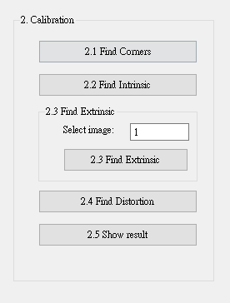
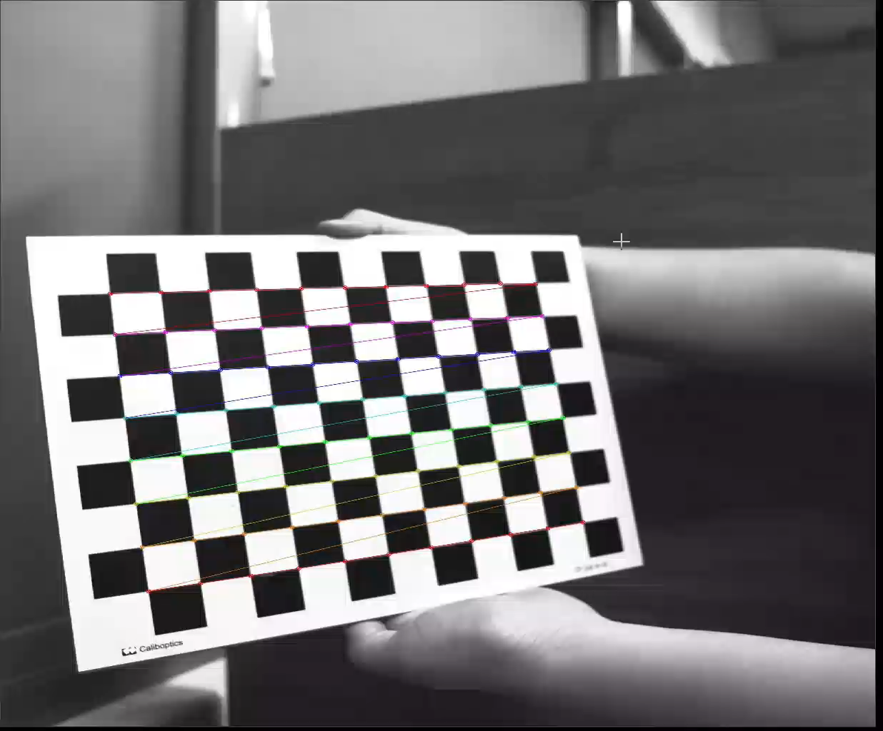
2.1 Corner Detection (4%)
(出題：West)
Given: 15 images, 1.bmp ~ 15.bmp
Q: 1) Find and draw the corners on the chessboard for each image.
2) Click button “2.1” to show each picture 0.5 seconds.
Hint :
OpenCV Textbook Chapter 11 (p. 398 ~ p. 399)
cv.findChessboardCorners(…)
Ex:
1

Slide 2
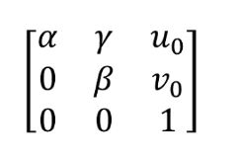
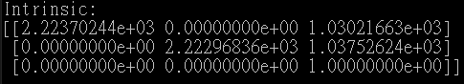
2.2 Find the Intrinsic Matrix (4%)
(出題：West)
Given: 15 images, 1.bmp ~ 15.bmp
Q: 1) Find the intrinsic matrix ():
2) Click button “2.2” and then show the result on the console window.
Output format:
Hint: OpenCV Textbook Chapter 11 (P.398 ~ p.400)
(Just an example)

Slide 3
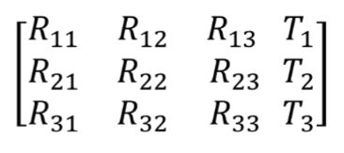
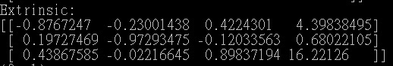
2.3 Find the Extrinsic Matrix (4%)
(出題：West)
Given: Intrinsic parameters, distortion coefficients, and the list of 15 images
Q: 1) Find the extrinsic matrix of the chessboard for each of the 15 images, respectively:
2) Click button “2.3” and then show the result on the console window.
Output format:
Hint: OpenCV Textbook Chapter 11, p.370~402
(Just an example)
(1) List of numbers: 1~15
(2) Select 1, then 1.bmp will be applied, and so on

Slide 4
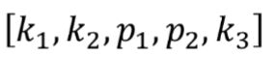

2.4 Find the Distortion Matrix (4%)
(出題：West)
Given: 15 images
Q: 1) Find the distortion matrix:
2) Click button “2.4” to show the result on the console window.
Output format:
Hint:
Distortion coefficients can be obtained simultaneously with intrinsic parameters
OpenCV Textbook Chapter 11 (P.398 ~ p.400)
(Just
an example)

Slide 5
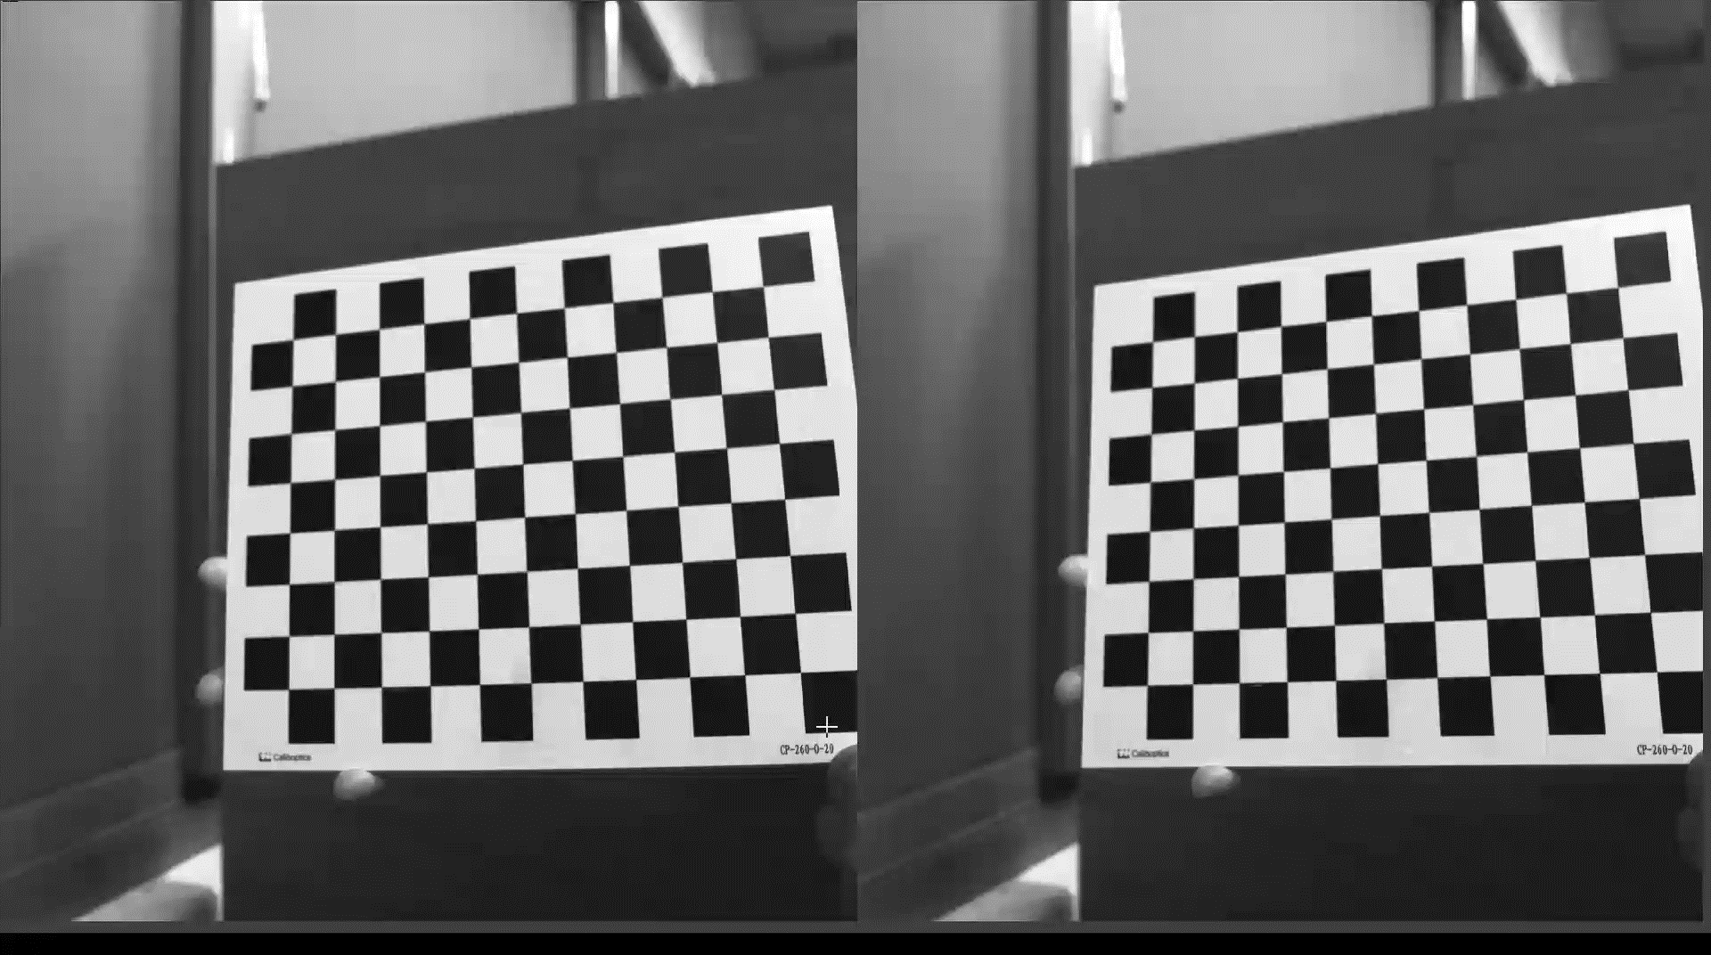
2.5 Show the undistorted result (4%)
(出題：West)
Given: 15 images
Q: 1) Undistort the chessboard images.
2) Show distorted and undistorted images.
Hint:
cv::undistort(…) or cv::initUndistortRectifyMap(…)
OpenCV Textbook Chapter 11 (P.398 ~ p.400)
Distorted image
Undistorted image

